Slide 1
OUTLIER DETECTION IN DISCRETE SEQUENCES
报告人：Jorfun

Slide 2
OUTLIER DETECTION IN DISCRETE SEQUENCES
sequences are discrete, values at the time stamps are categorical
As in the case of continuous data, outliers are of two types, depending upon whether specific positions are considered outliers, or whether combinations of symbols are considered outliers.
• Position Outliers(contextual outliers): Values at specific positions are predicted by a model. Determine the deviation from the model, predict specific positions as outliers.
• Combination Outliers(collective outliers): An entire test sequence is deemed to be unusual because of the combination of symbols in it.

Slide 3
Position Outliers
Definition:
The discrete positions at specific time-stamps can be predicted with the use of different models. When a position has very low probability of matching its forecasted value, it is considered an outlier.
Example:
Sequence 1: PlacedOnShelf, RemovedFromShelf, CheckOut, ExitStore. Sequence 2: PlacedOnShelf, RemovedFromShelf, ExitStore.

Slide 4
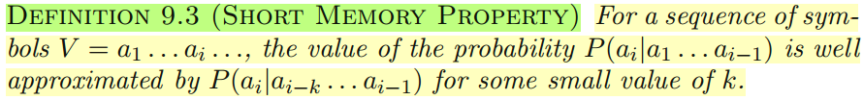
Position Outliers
It is assumed that the prediction of the values at a position depends upon this short history. This is known as the short memory property of discrete sequences, which generally holds true across a wide variety of temporal application domains [386].

Slide 5
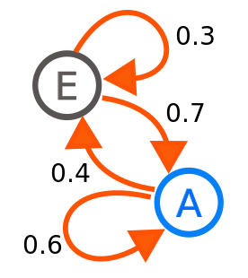
Position Outliers
Rule-based models
Markovian models
Technically equivalent
Exploit the short memory property of sequences in order to explicitly model the sequences as a set of states in a Markov Chain.

Slide 6
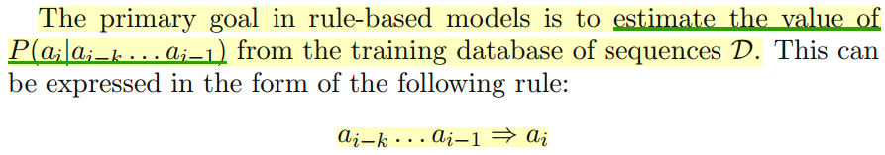
Position Outliers: Rule-based models
The probability of the prediction is typically quantified by the confidence of the rule.
supp(ai-k … ai-1, ai) / supp(ai-k … ai-1)

Slide 7
Position Outliers: Rule-based models
Key challenge: perform robust estimation of the rules from the training data.
Sparsity of the data creates a challenge: Even for small window sizes (value of k)......
In order to address this issue, a number of heuristic relaxations and variations of the basic probability estimation approach can be used.
Support Criterion (Both support and confidence criteria should be used)
supp(ai-k … ai-1, ai) / supp(ai-k … ai-1) and supp(ai-k … ai-1)
Variable Antecedent Size
“Don’t Care” Positions (a1a2 ∗ ∗a5 ⇒ a6)

Slide 8
Position Outliers: Rule-based models
Criterion for rule-generation
Support-confidence criterion
Classification rules (extracting windows from the training sequence, last symbol is treated as a class label)
Application-dependent criterion for the rule-generation process

Slide 9
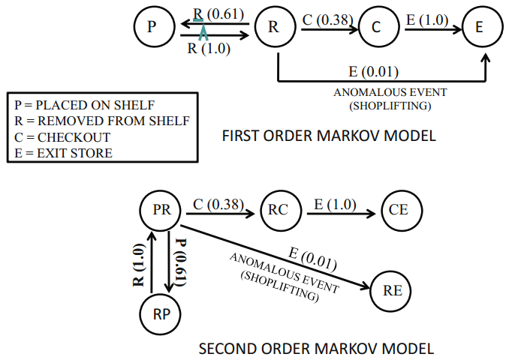
Position Outliers: Markovian Models
These models represent the sequence generation process with the use of transitions in a Markov chain.
Kth(short memory) order Markov Models

Slide 10
Position Outliers: Markovian Models
number of states AND value of K in k-order model
Higher order models
represent complex systems (theoretical)
degrades effectiveness - P (an|an−k . . . an−1)
degrades efficiency - larger number of states
有什么办法？

Slide 11
Position Outliers: Markovian Models
A number of relaxations and variations of order-k models can be constructed for greater robustness. These are analogous to the variations of rule-based methods.
Variable-order Models (achieve by Probabilistic Suffix Trees (PST))
High order low frequency -> low order generalizations
effectiveness
“Don’t care” subsequences (refer to as Sparse Markov Transducer)
effectiveness and efficiency

Slide 12
Rule-based models and Markovian Models
两者的关系：
Rule-based models can be considered heuristic simplifications of more complete Markovian models（状态转换，信息的保留）
The aforementioned variations are computationally challenging. (variable order)
Efficient data structures are required for representation and processing.
A lookup for a test subsequence ai−k . . . ai−1 is required in order to determine the probability of P (ai|ai−k . . . ai−1). (organize -> better retrieval)

Slide 13
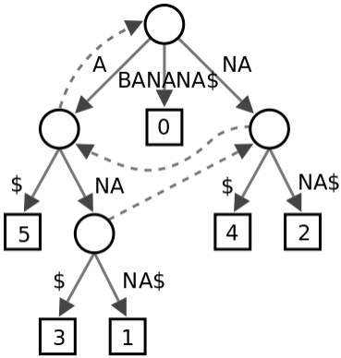
Efficiency Issues: Probabilistic Suffix Trees
Suffix trees
Compressed trie containing all the suffixes of the given text as their keys and positions in the text as their values.
Store all subsequences in a given database.

Slide 14
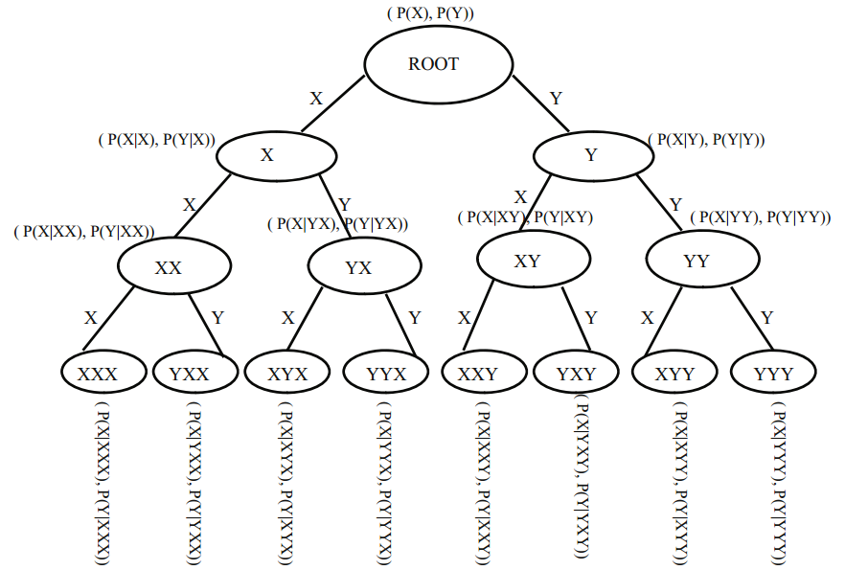
Efficiency Issues: Probabilistic Suffix Trees
PST (Probabilistic Suffix Trees)
Stores the conditional probabilities of generation of the next symbol for a given sequence database.
Encodes all the information required for variable order

Slide 15
Efficiency Issues: Probabilistic Suffix Trees
The probabilistic suffix tree is pruned significantly in order to improve its compactness.
suffixes which correspond to very low counts in the original data can be pruned from consideration. (minCount)
In order to create Markovian models of order k or less, it is not necessary to keep portions of the tree with depth greater than k.
nodes with low generative probabilities of their underlying sequences can be pruned from consideration (PMin)

Slide 16
Efficiency Issues: Probabilistic Suffix Trees
consider the sequence a1 . . . ai . . . an, in which it is desired to test whether position ai is a position outlier.
P (ai|a1 . . . ai−1) -> P (ai|aj . . . ai−1)
outlier scores may be defined from the suffix tree in multiple ways
Only short path lengths exist in the (pruned) suffix tree corresponding to a position ai and its preceding history, it is more likely be an outlier.
For the paths of lengths 1 . . . r, which do exist in the suffix tree for position ai, a combination score may be used based on the models of different orders. (some cases, only lower order scores are combined)

Slide 17
Position Outliers的应用场景
Position outliers can also be used for correcting noise in sequences, by replacing sequence values with predicted values. Predicted (corrected) values can be obtained from the suffix tree as the symbols with the highest probability of generation after a suffix.
Such methods can also potentially be used to correct grammatical errors in text sentences.

Slide 18
Combination Outliers
Combination Outliers(collective outliers): An entire test sequence is deemed to be unusual because of the combination of symbols in it.
The rarity in the combination of values can be defined in different ways depending upon the specific regularity model used for outlier analysis.
Distance-based (nearest neighbor distance)
Frequency-based (subsequences of values, between a test instance and the base training data)
Model-based (probabilistic generative model, subsequences with low probability of being generated by the model -> outliers)

Slide 19
Combination Outliers
sequence-based outlier detection arises in rather diverse scenarios
Unsupervised vs Semi-Supervised (At the formulation level, no difference)

Slide 20
Combination Outliers
sequence-based outlier detection arises in rather diverse scenarios
Long Test Sequence vs Short Test Sequence
when both the test sequences and training sequences are short
multidimensional methods for anomaly detection (k-nearest neighbor), point-based techniques
When the test and training sequences are long (curse of dimensionality)
!! comparison units !!: windows of the test sequence are extracted as small subsequences
the relative behavior of the comparison units is compared in both the training data and test sequence
notion of similarity (distance, frequency, generative probability)
Final anomaly score for a given test sequence = combination score from all the subsequences extracted from it.

Slide 21
Combination Outliers
sequence-based outlier detection arises in rather diverse scenarios
Single Long Training Sequence vs Many Training Sequences
little difference between these cases (logical view)
because these models describe the behavior of only a very small window of the data corresponding to the comparison unit

Slide 22
Combination Outliers
sequence-based outlier detection arises in rather diverse scenarios
Single Long Sequence which is undifferentiated between Training and Test Data
web logs, a single long sequence, determine unusual portions of this sequence
multi-granularity approach (extract test sequences of different lengths)
second level (comparison units)
relative difference between the derived test sequences and the training sequences

Slide 23
Combination Outliers
sequence-based outlier detection arises in rather diverse scenarios
Presence or Absence of Domain Knowledge about Relevant Comparison Units for Anomaly Detection
specific domain knowledge may be available about important comparison units (Login Password Login Password Login Password)
domain-dependent comparison units
improve the quality of the overall results (generally)

Slide 24
Combination Outliers
Aforementioned variations and techniques are also relevant to the case of outlier analysis in time-series data.
Relationship between Position and Combination Outliers
Possible to determine the outlier score for smaller test sequences by repeated use of position outliers
Probabilistic suffix tree of order k

Slide 25
Combination Outliers: Distance-based Models
The absolute distance of the comparison unit is computed to equivalent windows of the training sequence. The distance of the k-th nearest neighbor window in the training sequence is used in order to determine the anomaly score.
Proximity
Similarity
Distance

Slide 26
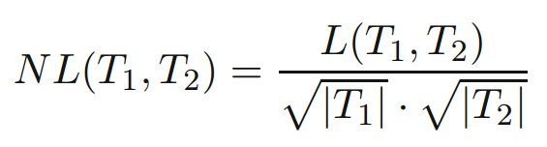
Combination Outliers: Distance-based Models
Common methods which are used in order to compute the similarity between a pair of sequences
Simple Matching Coefficient
determines the number of matching positions between two sequences of equal length
Normalized Longest Common Subsequence
unequal length

Slide 27
Combination Outliers: Distance-based Models
Common methods which are used in order to compute the similarity between a pair of sequences
Edit Distance
most common similarity functions used for sequence matching [196]
measures the distance between two sequences by the minimum number of edits required to transform one sequence to the other.

Slide 28
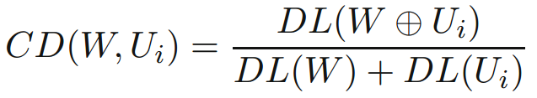
Combination Outliers: Distance-based Models
Common methods which are used in order to compute the similarity between a pair of sequences
Compression-based Dissimilarity
based on principles from information theory
W⊕Ui be the string representing the concatenation of W and Ui
DL(S) < |S| be the description length of any string S after applying a standard compression algorithm to it

Slide 29
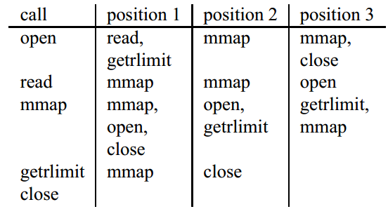
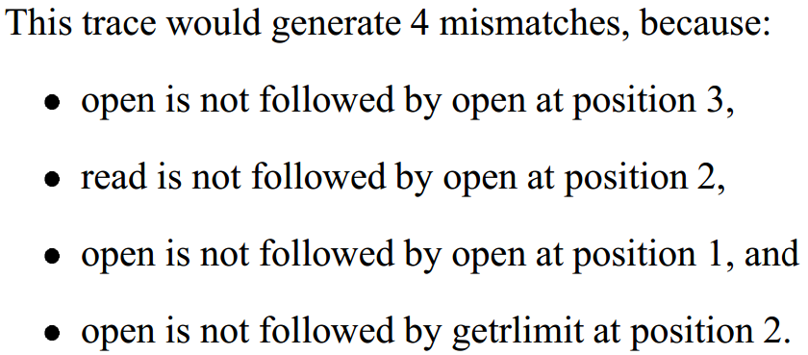
Combination Outliers: Distance-based Models
Common methods which are used in order to compute the similarity between a pair of sequences
counting mismatches among lookahead pairs

Slide 30
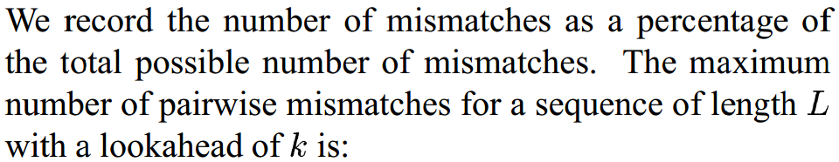
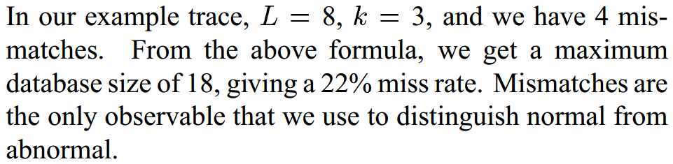
Combination Outliers: Distance-based Models
Common methods which are used in order to compute the similarity between a pair of sequences

Slide 31
Combination Outliers: Distance-based Models
Common methods which are used in order to compute the similarity between a pair of sequences
length-sensitive recursive computation of subsequence similarity
contiguous mismatches are more important than non-contiguous mismatches
for each position l in Ui, the length p of the longest contiguous set of positions to the left of position l is determined
aggregation
anomaly score for comparison unit wrt training sequences (extract equivalent windows, k-th nearest neighbor distance)
Combine results of different comparison units U1 . . . Ur extracted from V. How to combine???

Slide 32
Combination Outliers: Distance-based Models
The anomaly scores from different comparison units extracted from a test sequence can be combined together in order to create a global anomaly score for the test sequence V.
Combining Anomaly Scores from Comparison Units
Number of Anomalous Units
threshold
not account for varying levels of anomaly scores
Aggregate Anomaly Score
can be impacted from the noisy scores of windows which are not anomalous

Slide 33
Combination Outliers: Distance-based Models
Combining Anomaly Scores from Comparison Units
Selective Aggregate Anomaly Score
combine previous two
select windows with threshold, aggregate scores of these windows
Clustered Anomaly Scores
contiguous anomalous windows are generally more significant in application specific scenarios than anomalous windows which are arbitrarily distributed over the sequence
counter noisy scores of windows
Locality Frame Count
Leaky Bucket

Slide 34
Combination Outliers: Distance-based Models
Combining Anomaly Scores from Comparison Units
Locality Frame Count
examines each possible set of η contiguous comparison units, as a super-unit
number of anomalous units within this super-unit >= or <=? Threshold
Outlier score = total number of anomalous super-units
Leaky Bucket
comparison units are scanned in temporal order
a running count is maintained of the difference between the number of anomalous comparison units and the number of normal units.
running count is never allowed to fall below 0
Highest value of the running count over the entire sequence is reported as the outlier score.

Slide 35
Combination Outliers: Distance-based Models
Discussion
In many scenarios, comparison units may be provided by a domain expert, and may correspond to significant semantic events.
Distance
frequency-based
model-based methods (HMM)
Deviation VS Existence

Slide 36
Combination Outliers: Distance-based Models
Discussion
when the data contains a set of relatively short sequences of comparable size
multidimensional methods
k-nearest neighbor
CLUSEQ
k-medoid based clustering approach
probabilistic suffix trees: efficient representation of a cluster

Slide 37
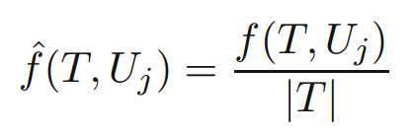

Combination Outliers: Frequency-based Models
Typically used with domain-specific comparison units, which are specified by the user.
Relative frequency of the comparison unit in the training sequences and the test sequences.
The absolute value of the average of these scores are computed over all the sequences in the database D = T1 . . . TN -> final anomaly score

Slide 38
Combination Outliers: Frequency-based Models
Special situation: Comparison units are specified by the user, may not always be of the compact size required for effective frequency computations.
frequencies in training sequences may be small or zero -> insignificant results
Two possible solution
uses subsequences of the comparison units, aggregate
allows relaxation of the definition of “subsequence” in counting frequencies, allowing permutations of the comparison unit.

Slide 39
Combination Outliers: Frequency-based Models
improve the efficiency of frequency computation
The training sequences should be decomposed into smaller windows for subsequence computations. (Rather than equal size window)
The number of windows in which the comparison unit occurs is used as a proxy for the frequency.

Slide 40
Combination Outliers: Frequency-based Models
Frequency-based Model with Extracted Comparison Units
While such methods are feasible, they have generally not been used very frequently in the literature. Distance-based methods are much more popular, when comparison units are extracted directly from the test sequences.
Combining Anomaly Scores from Comparison Units.
The same as discussed for distance-based methods

Slide 41
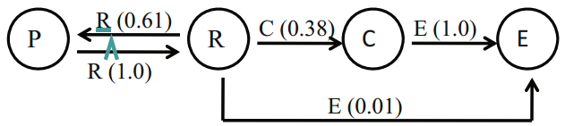
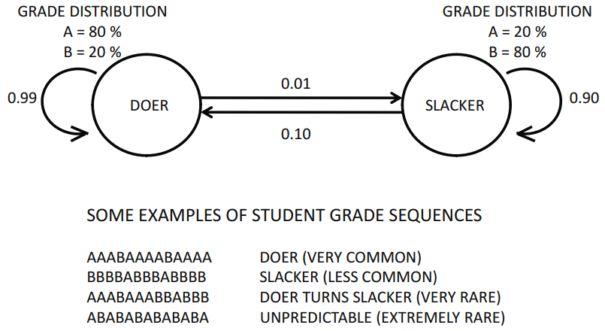
Combination Outliers: Hidden Markov Models
States: hidden
Only a sequence of discrete observations are visible (emission probabilities)
State definition - understanding of the underlying system
Precise sequence of transitions between the states - can only be estimated for a particular observed sequence

Slide 42
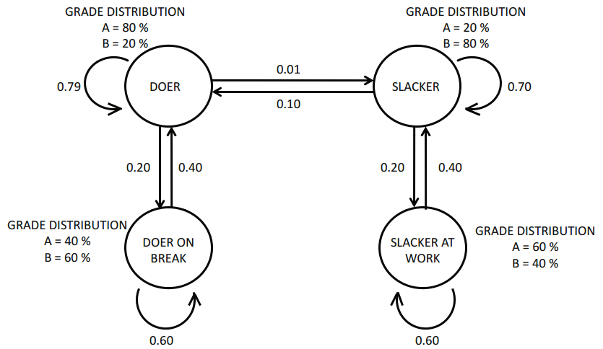
Combination Outliers: Hidden Markov Models
Encode domain knowledge with the use of states which describe different generating scenarios

Slide 43
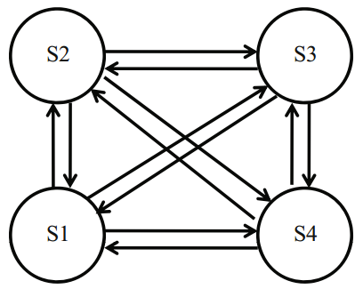
Combination Outliers: Hidden Markov Models
Design Choices in a Hidden Markov Model
Poor design could result in the model either overfitting the data or not fitting the training sequences at all
Two primary design choices exist in picking the parameters of a Hidden Markov Model
black-box VS domain-specific architecture (!!)
number of parameters need to be learned
bias, not truly reflect the actual behavior
number of states ~ level of complexity

Slide 44
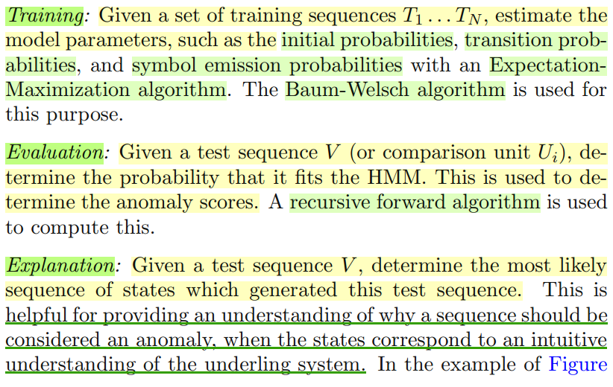
Combination Outliers: Hidden Markov Models
Methodologies commonly leveraged in creating and using a Hidden Markov Model

Slide 45
Combination Outliers: Hidden Markov Models
Computing Anomaly Scores
Short test sequence: compute anomaly scores directly for the test sequence V , once the training model has been constructed from the sequence database D = T1 . . . TN .
Long test sequence: comparison units
Absolute (combine scores of all units)
Relative (two separate Markov Models, Forward Algorithm) - used rarely

Slide 46
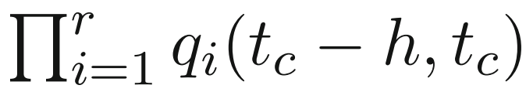
Complex Sequences and Scenarios
Multivariate Sequences
Description: Multiple sensors may record sequences drawn from possibly different alphabets.
Solution: A variety of solutions are possible for finding unusual time-windows by combining the results from univariate analysis of the different series.

Slide 47
Complex Sequences and Scenarios
Set-based Sequences
Description: In practice, each unit element of the sequence may be a set Si ⊆ Σ.
Solution:
first-story detection (document) or clustering
temporal description length (bits requited to encode): determine item sets and data segments which reflect significant changes in correlations over time.
In general, set-based sequences are much closer in spirit to sparse multidimensional data.
Aggregate change analysis

Slide 48
Complex Sequences and Scenarios
Online Applications: Early Anomaly Detection
Position Outliers
Prediction is dependent only on a short memory before the position being predicted
probabilistic suffix trees, efficiently updated
Combination Outliers
comparison unit

Slide 49
Supervised Outliers in Sequences
Many patterns which are discovered as outliers may correspond to noise, and may not represent true anomalies.
Distinguish noise from anomalies by incorporating additional knowledge about previously known (and interesting) examples into the outlier analysis process.
Most of the methods for classification of sequence data are not designed for the imbalanced case
Use meta-algorithms discussed in Chapter 6. (classification, clustering, improve robustness of underlying solution)
Issue of class imbalance is orthogonal to the actual techniques which are used for sequence classification.

Slide 50
Supervised Outliers in Sequences
The problem of supervised outlier detection in sequence data is equivalent to sequence classification.
A brief review of the main classes of techniques
Feature Transformations (k-grams, pattern-based methods, wavelet decomposition)
Distance-based Methods (edit distance)
Hidden Markov Models (create a generative model which is specific to each class)
For a given test sequence, the evaluation algorithm is used to determine the identity of the best fit class.

Slide 51
其他
与“Anomaly Detection for Discrete Sequence: A Survey”的区别
研究中的运用，Position Outlier

Slide 52
感谢聆听

